Slide 1







Technology Trends & Analysis Presentation
TEJA ROJNIK MAHER
OCT 26, 2021

Slide 2



TABLE OF CONTENT
Executive Summary
Introduction
Methodology
Results
Visualization – Charts
Dashboard
Discussion
Findings & Implications
Conclusion
Appendix

Slide 3

EXECUTIVE SUMMARY
Determine the trends and distribution of the programming languages, databases and platform based on numbers of respondents
Trends were analyzed based on 3 factors:
Current Technology Usage
Future Technology Usage
Demographics
Classification has been made on gender and number of respondents

Slide 4

INTRODUCTION
ABOUT:
-To visualize the data, dashboards were created to emphasis on the present and future trends of data technologies
PURPOSE:
-Identify skill requirements for future
-What are the top programming languages in demand?
-What are the top database skills in demand?
-What are the popular IDEs?
• AUDIENCE:
-Human Resource and IT Head

Slide 5

METHODOLOGY
Collecting data
• Stack Overflow Developer 2019 Survey
• GitHub Job Postings • Programming Languages Annual Salary
Exploring the data
Data Wrangling(Duplicates and null values were detected and removed, data was normalized)
Data Analysis (Distribution of data was checked, Outliers were identified and removed, Correlation was identified)
Data Visualization (Dashboards were created with different visual charts for easier understanding of the data)

Slide 6
PROGRAMMING LANGUAGE TRENDS
Current Year
Next Year
<Bar chart of top 5 programming languages for the current year goes here.>
< Bar chart of top 5 programming languages for the next year goes here.>

Slide 7
PROGRAMMING LANGUAGE TRENDS - FINDINGS & IMPLICATIONS
Findings
Two most preferred languages were JavaScript and HTML – due to growing internet and friendly syntax.
Followed by SQL, Bash/Shell and Phyton.
Implications
JavaScript and HTML will continue to be preferred languages although with less interest.
Phyton will become one of the top 3 preferred languages

Slide 8
DATABASE TRENDS
Current Year
Next Year
< Bar chart of top 5 databases for the current year goes here >
< Bar chart of top 5 databases for the next year goes here.>

Slide 9
DATABASE TRENDS - FINDINGS & IMPLICATIONS
Findings
Database platform that dominated as a platform preferred by developers was MySQL.
Microsoft SQL and PostgreSQL were second most used with very similar numbers of downloads
MongoDB and Redis are upcoming favorites
New kid on the block: Elasticsearch
Implications
In the upcoming years we can expect a high growth in PostgreSQL.
Just as that it will be important to have knowledge of MongoDB and Redia
Open-source databases are still preferable in companies
NoSQL databases will make an impact for storing non-relational data

Slide 10

DASHBOARD
Click for a dashboard created with IBM Dashboard platform

Slide 11
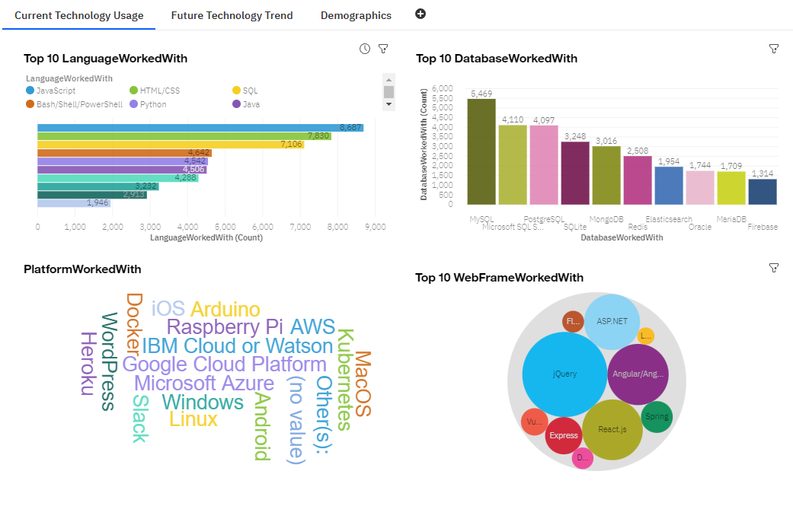
CURRENT TECHNOLOGY USAGE DASHBOARD

Slide 12
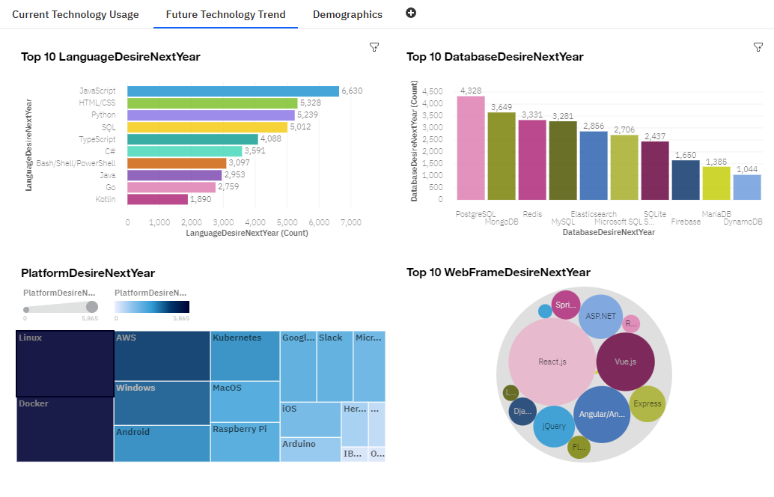
FUTURE TECHNOLOGY TREND DASHBOARD

Slide 13
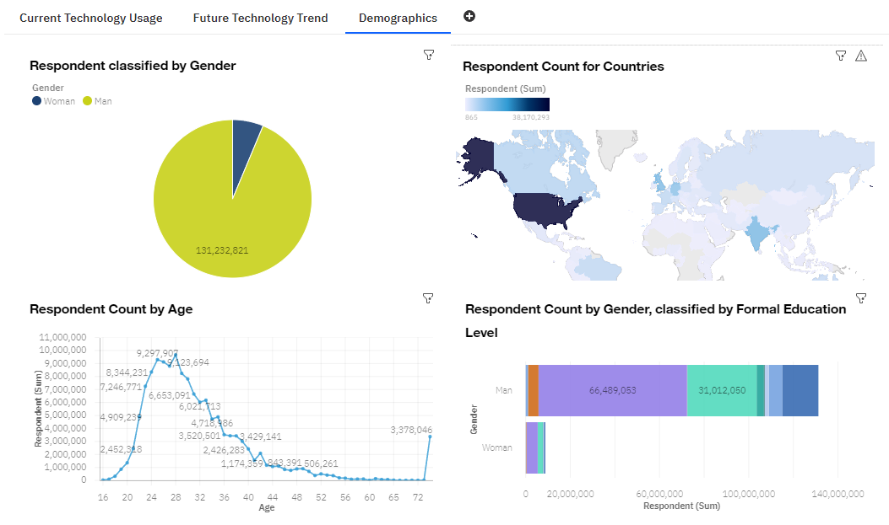
DEMOGRAPHICS DASHBOARD

Slide 14
DISCUSSION
Technology Trends now and future
Training and Reskilling workers
Female participation in technology field
Bridge divide of technology gaps in developing countries
Eliminate age and education discrimination in employment
Will Phyton continue to grow, or will it be replaced by any other languages?
Will SQL exist and if so, who will be the major market player?

Slide 15
OVERALL FINDINGS & IMPLICATIONS
Findings
Gender gap in technology jobs -surveys results shows strong domination by male population aged between 21 to 45.
Fast changing technology every year
Undergraduates and postgraduates highly prefer using a specialization in data technology
Implications
Due to high demographics using programming languages in the US, we could see this influence around the world.
Companies need to be flexible and adjust to rapid changes
Need to spread technology out to lagging countries
Shift to faster app deployments and cloud services in future

Slide 16

APPENDIX
Resources used; database taken from:
-Stack Overflow for hosting dataset as ODBL: Open Database License
-IBM Congos dashboard was used for creating dashboards

Slide 17
GITHUB JOB POSTINGS

Slide 18
POPULAR LANGUAGES BY SALARY

